Slide 1
Remote provisioning con PnP Framework
Luis Mañez
Notes:
This slide is mandatory. Please do not remove.

Slide 2

Luis Mañez
SharePoint / Cloud Solutions architect
ClearPeople LTD
http://geeks.ms/lmanez/
@luismanez
SharePoint and Cloud solutions architect en ClearPeople. Cerca de 15 años trabajando con tecnologías Microsoft. SharePoint MCPD y Certified specialist in Developing Azure. OfficeDev PnP Key contributor.

Slide 3
Notes:
This slide is mandatory. Please do not remove and try to use it during Q&A at the end of your session. Thank you!

Slide 4
Agenda

Slide 5
Introducción al programa PnP
Componentes
Hello PnP demos
Provisioning framework

Slide 6

Introducción al programa PnP
Iniciado hace mas de 2 años
Por y para la comunidad
Ayuda con la transicion al modelo cliente
http://dev.office.com

Slide 7

Componentes (I)
PnP Core: https://github.com/OfficeDev/PnP-Sites-Core
PnP JavaScript Core: https://github.com/OfficeDev/PnP-JS-Core
PnP Provisioning Schema: https://github.com/OfficeDev/PnP-Provisioning-Schema
PnP PowerShell: https://github.com/OfficeDev/PnP-PowerShell
PnP Partner Park: https://github.com/OfficeDev/PnP-Partner-Pack
PnP Samples: https://github.com/OfficeDev/PnP

Slide 8
Componentes (II)
PnP Samples
PnP PowerShell CmdLets
PnP Partner Pack
PnP Provisioning Schema
PnP Provisioning Framework
PnP Remote Timer Job Framework
PnP JavaScript Core
PnP Core
JSOM
REST API
CSOM
SharePoint

Slide 9

Hello World PnP Demo

Slide 10
PnP PowerShell Demo

Slide 11
PnP Provisioning Framework
Permite exportar sitio como Template XML
Permite importar una template a SharePoint
Utiliza un Schema XML propio
No todo el Schema está soportado actualmente
Updates basados en “Deltas”
No es una herramienta para migrar contenido

Slide 12
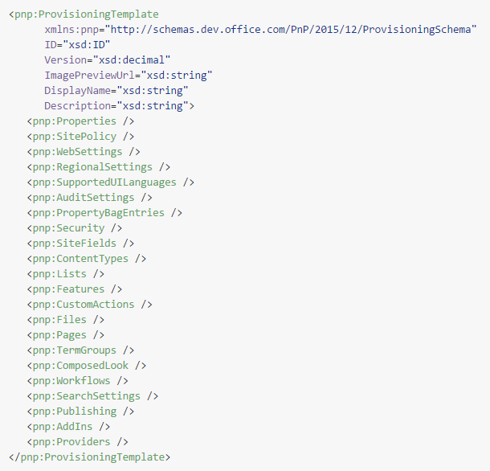
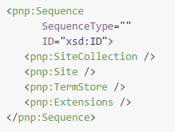
PnP Provisioning Framework - Schema
No Implementado

Slide 13
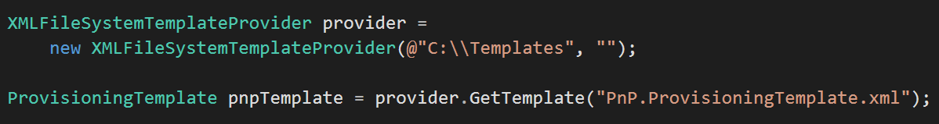
PnP Provisioning Framework - Arquitectura
JsonTemplateProvider
JsonFileSystemTemplateProvider
JsonAzureStorageTemplateProvider
JsonSharePointTemplateProvider
TemplateProviderBase
[Method]
GetTemplate
XmlTemplateProvider
FileConnectorBase
XmlFileSystemTemplateProvider
FileSystemConnector
Stream
XmlAzureStorageTemplateProvider
AzureStorageConnector
XmlSharePointTemplateProvider
SharePointConnector
ITemplateFormatter
XMLPnPSchemaFormatter
JsonPnPSchemaFormatter
ProvisioningTemplate
Field
ContentType
File
ListInstance
Page
…
Abstract class
Interface
RegionalSettings
TermSet

Slide 14
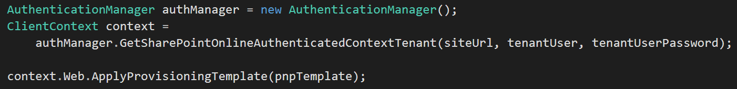
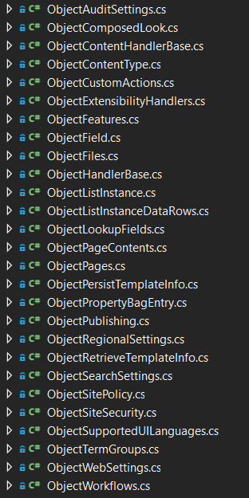
PnP Provisioning Framework - Arquitectura
ObjectHandlers
Provisioning Template
WebExtensions
ApplyProvisioningTemplate
TokenParser
SharePoint
Extensibility Handlers

Slide 15
PnP Provisioning Framework Demo

Slide 16
Thank you!! … questions? …

Slide 17
Notes:
This slide is mandatory. Please do not remove and try to use it during Q&A at the end of your session. Thank you!

Slide 18
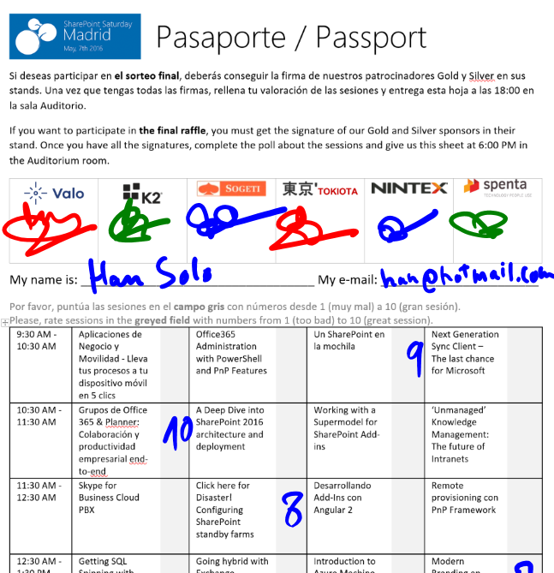

Raffle
Please, fill your SPS Madrid passport if you want to participate.
You must get signature from sponsors and complete the poll.
Give us the passport at 6:00 PM in the Auditorium room.
You can win one Sphero BB-8 or a mini drone:

